Slide 1

Dimensionality reduction and PCA

Slide 2
Contents
Introduction to dimensionality
Why dimensionality redcution?
Principle component analysis

Slide 3
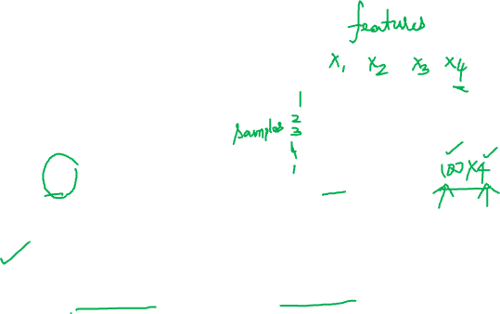
Introduction to dimensionality
Data matrix
Samples (rows)
Columns (attributes)
If the attributes are D and the samples are N
The size of the data matrix is N x D
Dimensionality
Refers to the number of attributes in the data matrix

Slide 4

Example
Consider Iris data
We have 4 features, $1$ output variable and 150 samples
Data matrix
Sample/Feature | X₁ | X₂ | X₃ | X₄ | Y (Class)
1
2
:
150

Slide 5

Example
What is the dimensionality of feature space?
Number of attributes or features =4
Dimensionality =4
Sample/Feature | X₁ | X₂ | X₃ | X₄ | Y (Class)
1
2
:
150

Slide 6
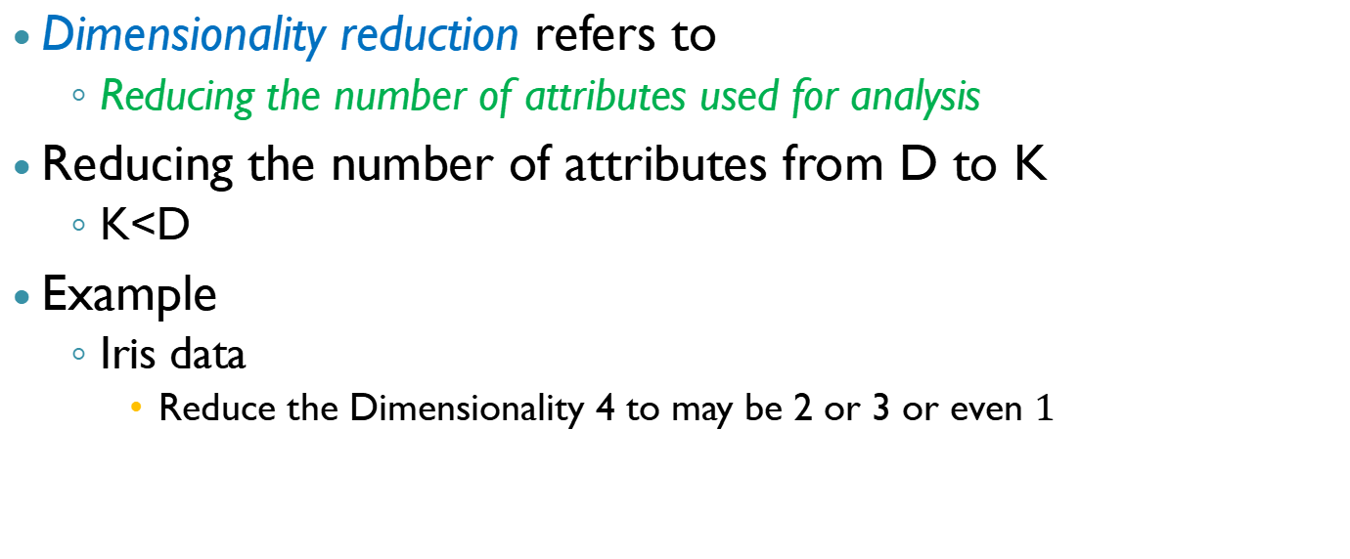
Dimesionality reduction
Dimensionality reduction refers to
Reducing the number of attributes used for analysis
Reducing the number of attributes from D to K
K<D
Example
Iris data
Reduce the Dimensionality 4 to may be 2 or 3 or even $1$

Slide 7
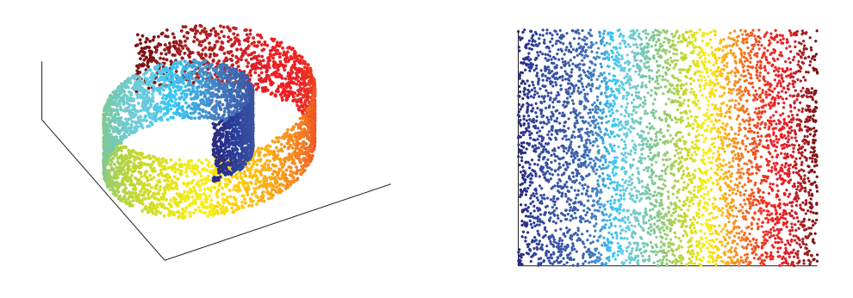
Pictorially (3D to 2D)

Slide 8
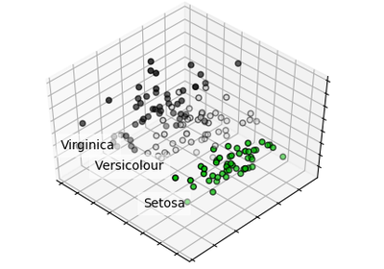
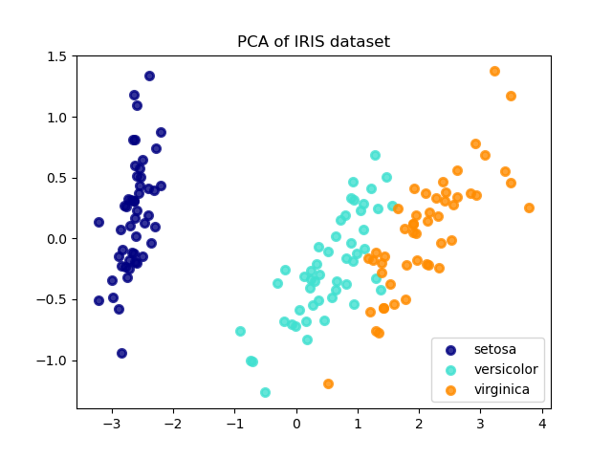
Iris example (4D to 3D and 2D)
4D
Sepal length
Sepal width
Petal length
Petal width
https://scikit-learn.org/stable/auto_examples/decomposition/plot_pca_iris.html#sphx-glr-auto-examples-decomposition-plot-pca-iris-py
https://scikit-learn.org/stable/auto_examples/decomposition/plot_pca_vs_lda.html#sphx-glr-auto-examples-decomposition-plot-pca-vs-lda-py

Slide 9

Why dimensionality reduction?
Any thoughts?

Slide 10
Why dimensionality reduction?
Curse of dimensionality
Decreases the complexity of the model and its inference
Simple models are robust on small datasets
Fewer features
Better idea to understand the underlying process
Latent variables/hidden variables
Reduced memory and computation
Visualization
2D and 3D data can be analysed and visualized for patterns and outliers

Slide 11
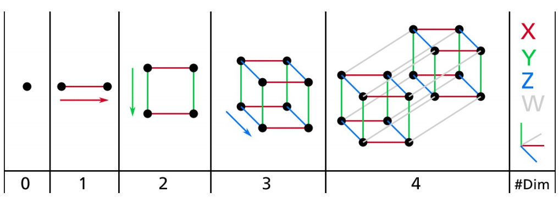
Curse of dimensionality
When the number of features is more
The data matrices become sparser
The distances between the samples increase tremendously
Making predictions in the higher dimensions is less reliable than making predictions in lower dimensions with the same number of samples
One possible solution
Have more training instances to have sufficient density for making reliable predictions
Cavet: Number of training samples required for maintaining sufficient training instances increases exponentially with the number of dimensions/features

Slide 12
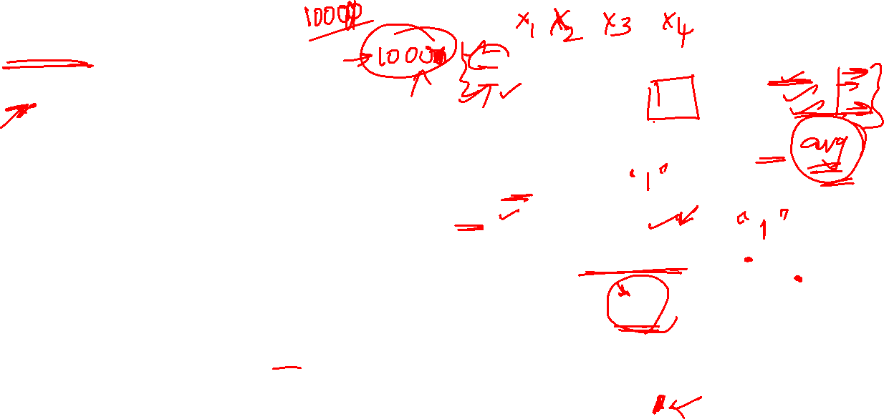
Sparsity example
If you pick two points randomly in a unit square
the distance between these two points will be, on average, roughly 0.52.
If you pick two random points in a unit 3D cube
the average distance will be roughly 0.66.
What about two points picked randomly in a 1,000,000-dimensional hypercube?
The average distance, believe it or not, will be about 408.25 (roughly )!
This is quite counterintuitive: how can two points be so far apart when they both lie within the same unit hypercube?

Slide 13
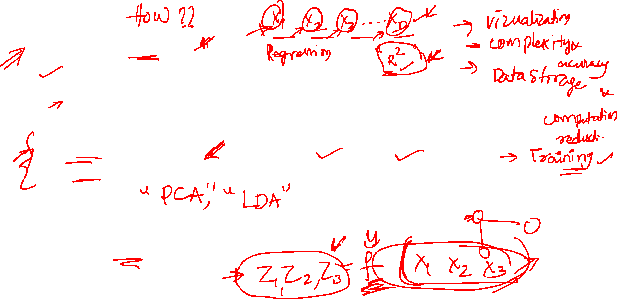
Methods of dimensionality reduction
Feature selection
selecting a few from the existing features
Forward selection (start with none, select each feature and ...)
Backward selection (start with all, reduce one at a time and ...)
Feature extraction
Extract fewer features as transformation/combination of existing features
Focus is on feature extraction methods
What guides these combinations?

Slide 14
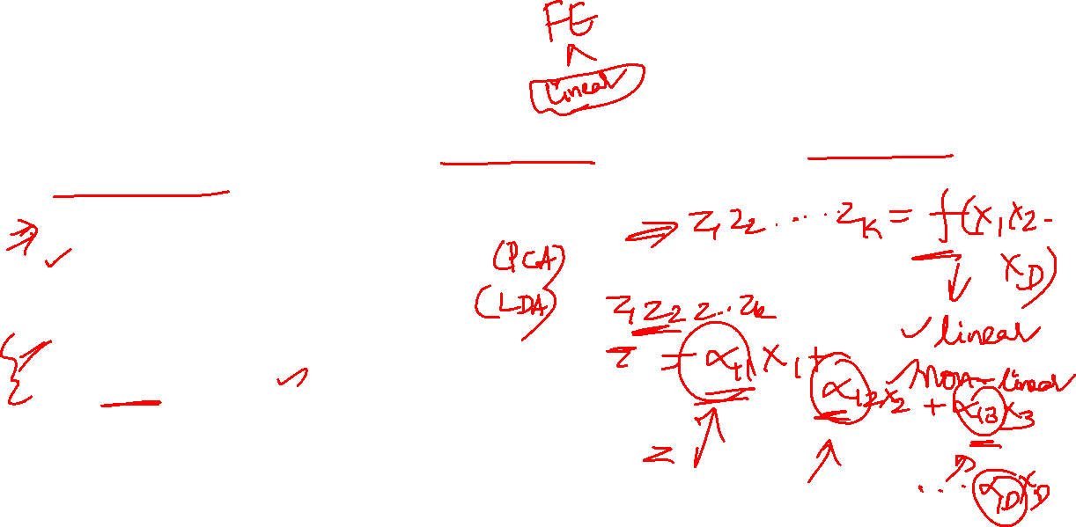
Feature extraction
The idea is to obtain the new features from the combination of existing features
Linear combination of attributes
Principle component analysis
Linear discriminant analysis
Non-linear combination of attributes
Kernal PCA
How do you choose the right combinations (projections or transformations)?

Slide 15
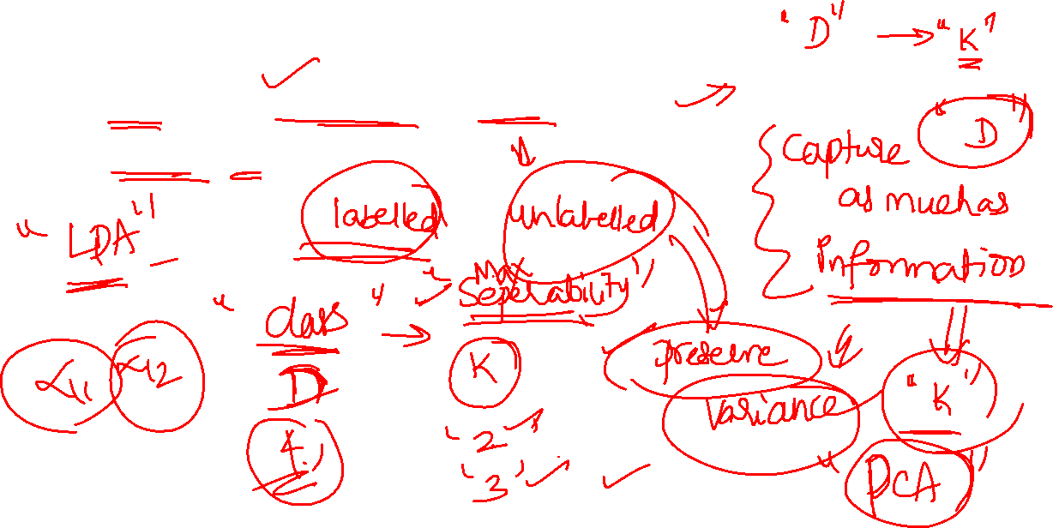
Combinations are chosen based on
Goals of dimensionality reduction and
The data available

Slide 16
Linear transformation-based techniques
Unsupervised learning framework (labels are not available)
The goal is to find the combinations of the variables that reduce the dimensionality and preserve the variance in the data
Example: PCA
Supervised learning framework (labels are available)
The goal is to find the combinations of the variables that reduce the dimensionality and preserve the class separability
Example: LDA

Slide 17
Principle component analysis

Slide 18
Principle component analysis
PCA
Unsupervised framework
Only features are used (no lables are available)
Find the lower dimensional hyperplane, which preserves the maximum variance in the data
Project the data onto the hyperplane

Slide 19
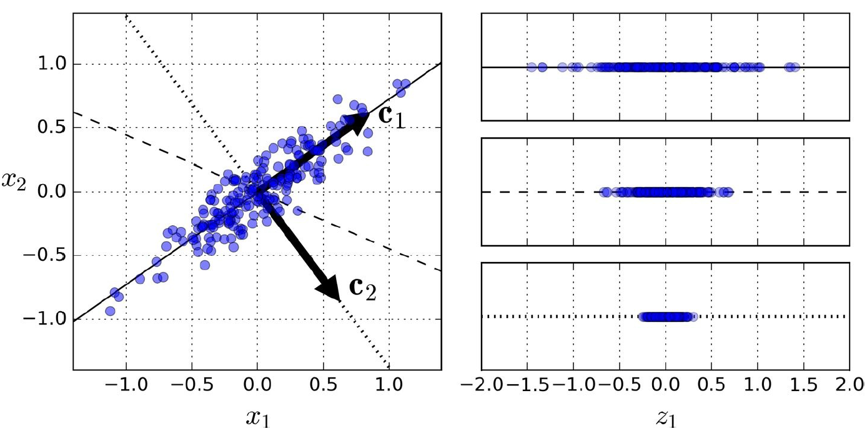
Geometric intution of 2D to 1D and PCs

Slide 20

The rationale for choosing the projection
Intuition
More likely to lose less information
Algebraic
The hyperplane that preserves the maximum variance is
the one that minimizes the mean squared distance between the original dataset and its projection onto the lower dimension subspace

Slide 21
Orthogonality of PCs
PCA identifies the axis that accounts for the maximum variance in the data
It also finds an axis that is orthogonal to the first axis, that accounts for the largest amount of remaining variance
In a higher dimensional plane, PCA identifies the third axis that is perpendicular to both the previous axis and explains the maximum of the variance left out

Slide 22
Intution
Goal
Project the data into lower dimensional hyperplane which preserves maximum variance in the data
Usually we select the number of Principal components that preserves 95% variance
What matrix will explain the variance in the data with multiple features?
Answer: Covariance matrix
Covariance matrix
top singular vectors of Covariance matrix are the directions of maximal variance in the data
the associated singular values are equal to these variances

Slide 23
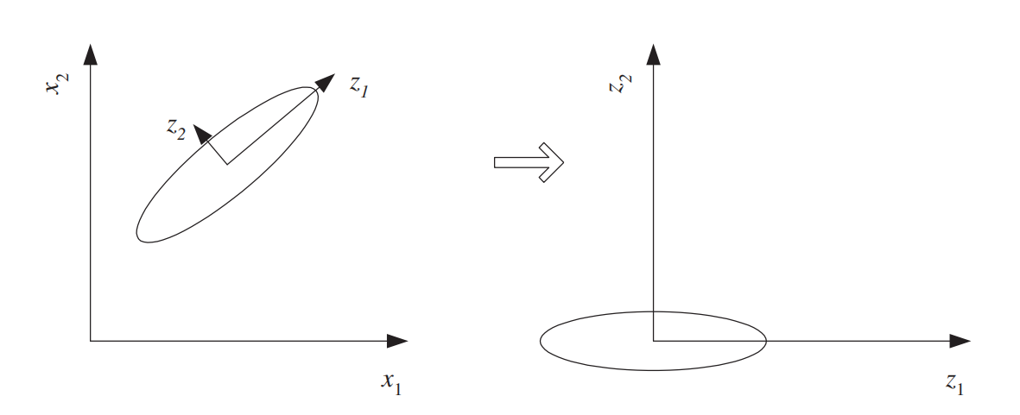
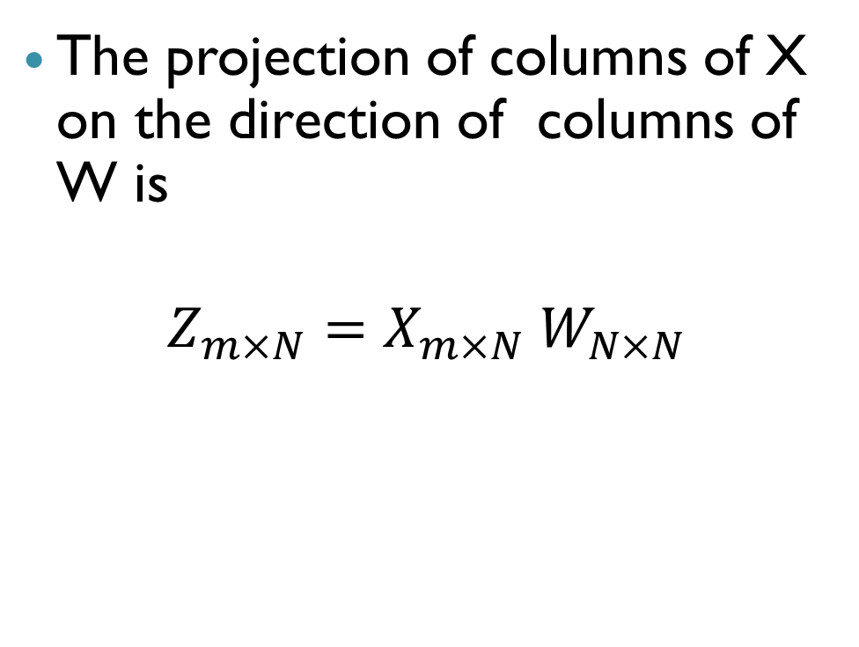
Mathematically
The projection of columns of X on the direction of columns of W is
$$Z_{m×N}=X_{m×N} W_{N×N}$$
Principal components matrix
Trasformed data matrix
Original data matrix

Slide 24
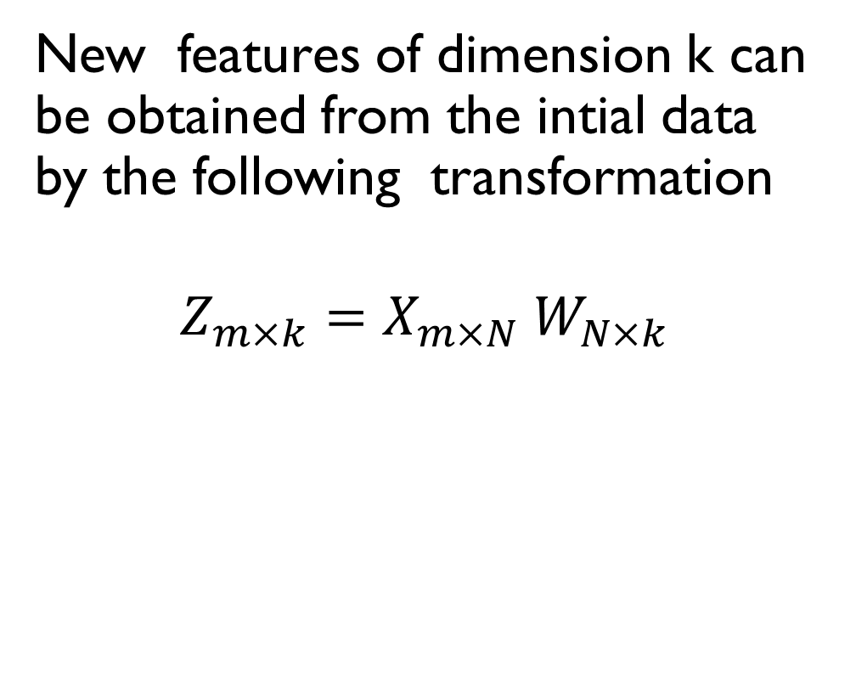
New features of desired dimension k
New features of dimension k can be obtained from the intial data by the following transformation
$$Z_{m×k}=X_{m×N} W_{N×k}$$
Principal components matrix
Trasformed data matrix in k dimensions
Original data matrix

Slide 25
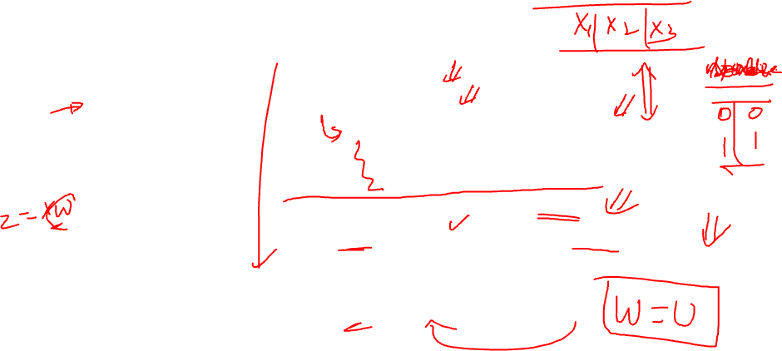
Procedure to find Principal components
Data matrix (X_{mxN})
Procedure
Preprocess the data
Centre the data
Susbtract the mean form each feaure
Scale the features
Scale features with the variance of range (better to do, if the features are having orders of magnitude difference)
Calculate the Sample covariance matrix (S)
Perform SVD of S
U matrix from the SVD of S will have PCs as its columns
Choose number of PCs to be used ( matrix of colums of U used is W)
Perform a transformation
Z = XW
X₁ | X₂ | ...... | X_{N}

Slide 26
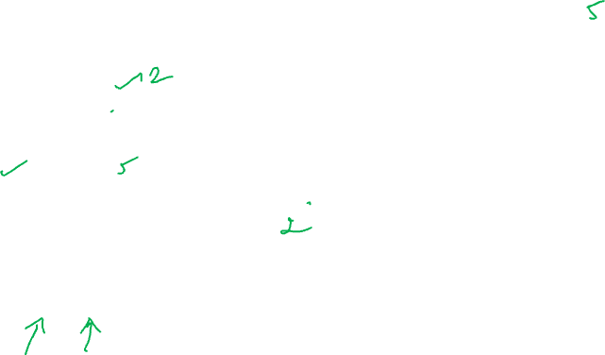
Example (2D to 1D)
Consider this 2 dimesional data
X₁ | X₂
2.5 | 2.4
0.5 | 0.7
2.2 | 2.9
1.9 | 2.2
3.1 | 3.0
2.3 | 2.7
2 | 1.6
1 | 1.1
1.5 | 1.6
1.1 | 0.9

Slide 27
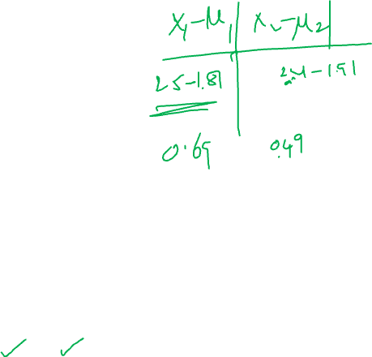
Step 1: Preprocess the data (means of features)
X₁ | X₂
2.5 | 2.4
0.5 | 0.7
2.2 | 2.9
1.9 | 2.2
3.1 | 3.0
2.3 | 2.7
2 | 1.6
1 | 1.1
1.5 | 1.6
1.1 | 0.9
1.81 | 1.91

Slide 28
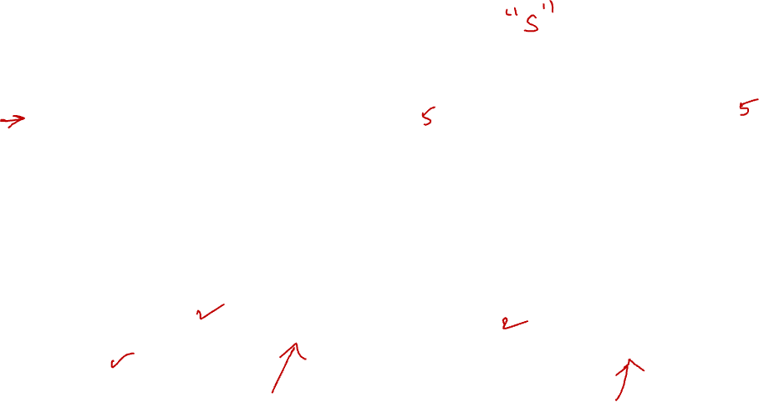
Step2: Mean centering
X₁ | X₂
0.69 | 0.49
-1.31 | -1.21
0.39 | 0.99
0.09 | 0.29
1.29 | 1.09
0.49 | 0.79
0.19 | -0.31
-0.81 | -0.81
-0.31 | -0.31
-0.71 | -1.01

Slide 29
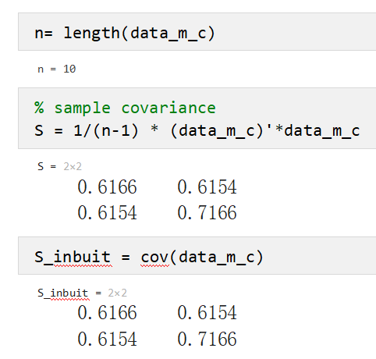
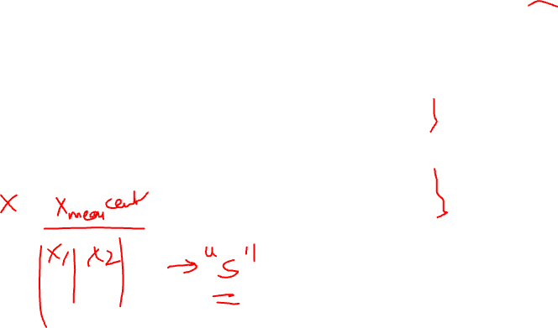
Step3: Sample covariance matrix (S)
If the data matrix is X (mean centred)
then the sample covariance matrix of the data can be calcualted by

Slide 30
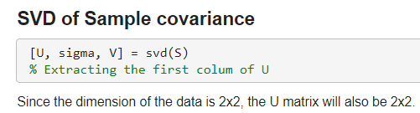
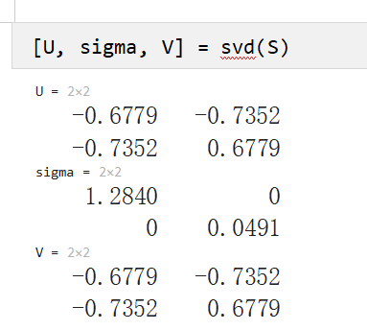
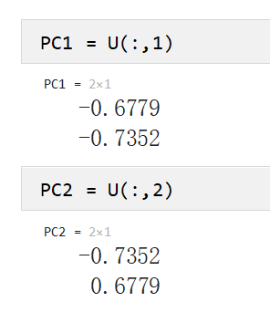
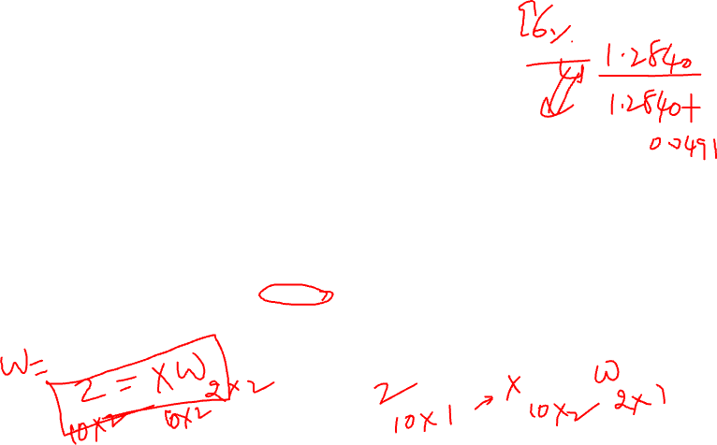
Step3: SVD of S to find PCs
SVD of s
[U,Sigma,V] = svd(S)

Slide 31
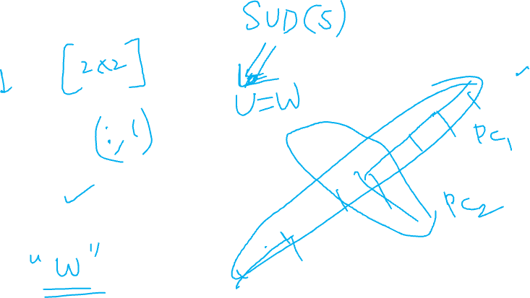
Step3: Directions of PCs

Slide 32
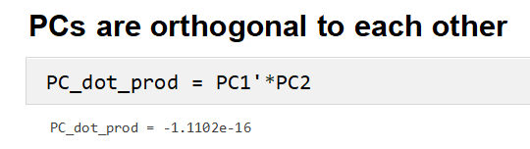

Orthogonality of PCs revisited
PC₁ and PC₂ are othrogonal to each other
PC₁ is a line which captures the maximum variance in the data
PC₂ is orthogonal to PC₁ and explains the maximum variance in the data after PC₁

Slide 33
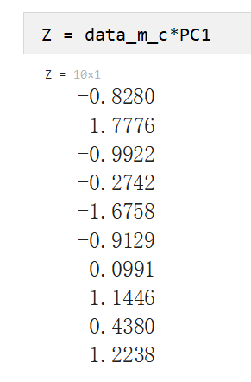
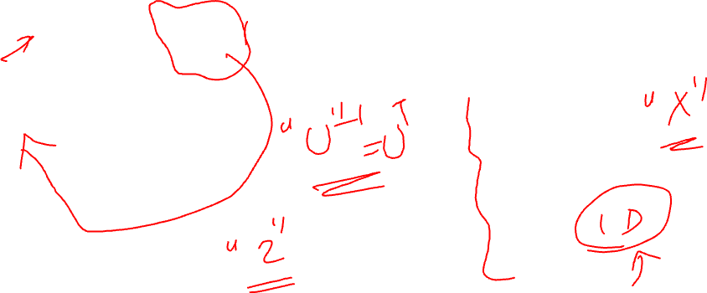


Step 4: Lower dimesional data matrix
$$Zm×k =X m×N W N ×k$$
Original data of size 10x2 can be now reduced to 10x1 by considering first PC from the 2 PCs of U
$Z$ _{10x1}=X _{10x2}U_{red} _{2x1}
where

Slide 34
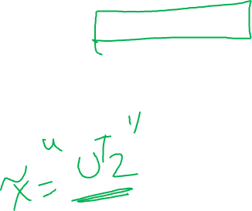
Step 4: Lower dimesional data matrix
Since a singular value decomposition of S produced U and V, they are Orthonormal matrices i.e,
$Z$ _{10x1}=X _{10x2}U_{red} _{2x1}
Original data of 10x2 can be now reduced to 10x1 by considering first PC from the 2 PCs of U

Slide 35
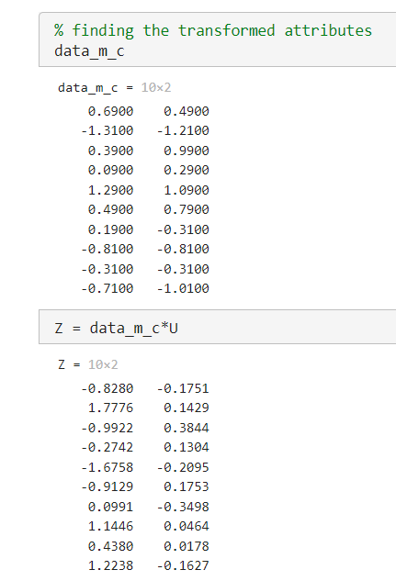
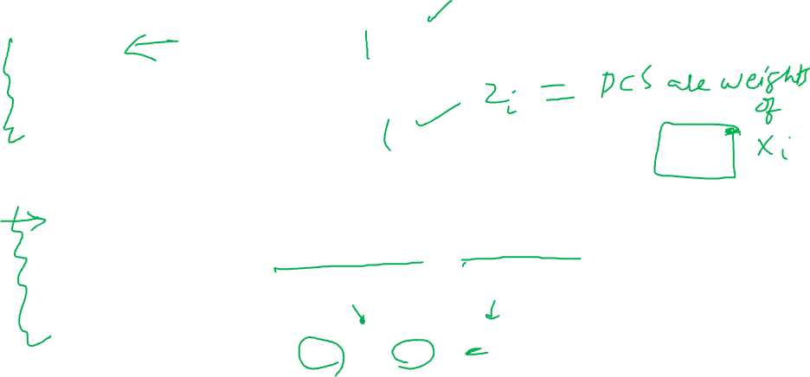



Z as linear combination of X with PCs as weights
$$Zm×N =X m×N W N ×N$$
sample 1 in transformed data
PC matrix
sample 1 in
original data
Z₁₁ Z₁₂
X₁₁ X₁₂
$Z11=−0.6779∗X11$ + (-0.7352)* $X12$
$Z12=−0.7352∗X11$ + 0.6679* $X12$

Slide 36


Uncorrelation of the transformed features
The number of new variables Z are as many as the initial variables.
However, they are uncorrelated as opposed to initial attributes.
$$Zm×N =X m×N W N×N$$

Slide 37
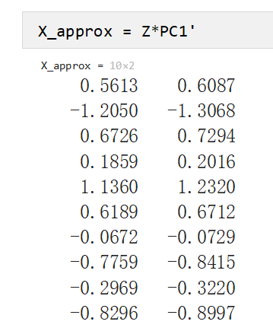


Reconstructing approximate original data
X _{10x2} ≈ $Z$ _{10x1} U^{T}_{red 1x2}
Using 1 PC to reconstruct X approximately

Slide 38
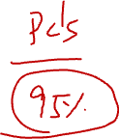
Plotting X (mean centered) and X approx

Slide 39
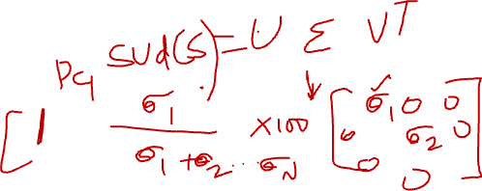
How to select number of PCs?
Selection of number of PCs
Percentage of explained variance by the PCs
Generally
select the number of PCs that can explain the 95% variance in the data
One way
run the full svd with a for loop from 1 to N PCs and see the variance explained as the number of PCs increases
Tedious
Other and easier way
use sigma values obtained from the SVD of the sample covariance matrix
Sigma is a diagonal matrix with the singular values of Covariance matrix arranged in descending order

Slide 40
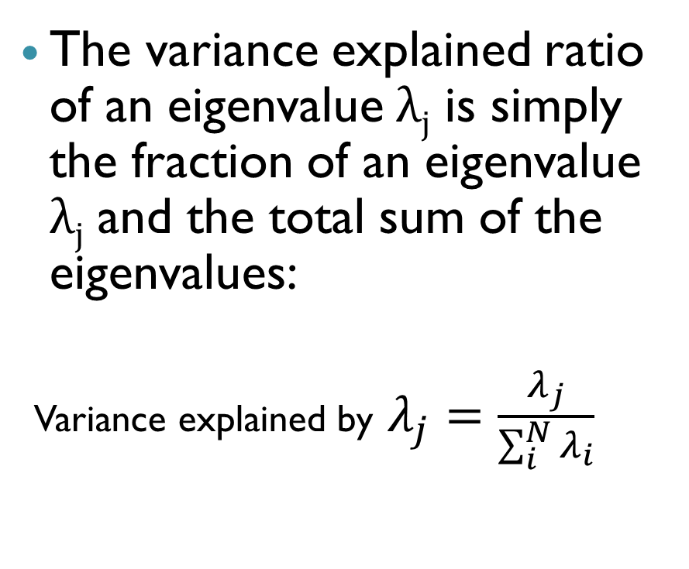
Number of PCs to be considered
Selection of number of PCs
Percentage of explained variance by the PCs
Generally
select the number of PCs that can exaplain the 95% variance in the data
The variance explained ratio of an eigenvalue $λj$ is simply the fraction of an eigenvalue $λj$ and the total sum of the eigenvalues:
Variance explained by $λ_{j}=\frac{λ_{j}}{\sum_{i}^{N}{λ_{i}}}$

Slide 41
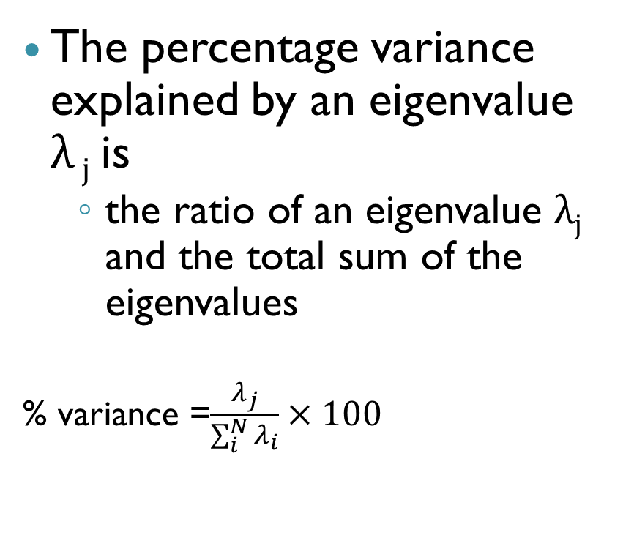

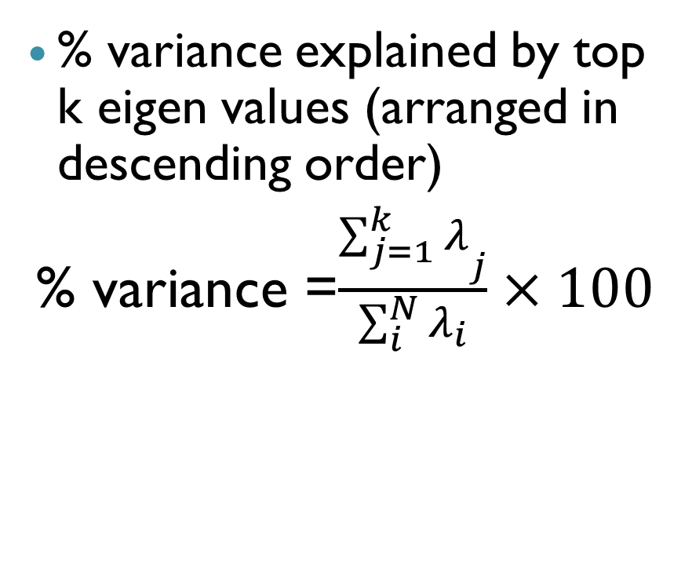
Number of PCs to be considered
The percentage variance explained by an eigenvalue $λ j$is
the ratio of an eigenvalue $λj$ and the total sum of the eigenvalues
% variance =$\frac{λ_{j}}{\sum_{i}^{N}{λ_{i}}}×100$
% variance explained by top k eigen values (arranged in descending order)
% variance =$\frac{{\sum_{j=1}^{k}{λ}}_{j}}{\sum_{i}^{N}{λ_{i}}}×100$

Slide 42

Scree plot
A plot with number of PCs in X axis and the eigen values corresponding to them in Y axis

Slide 43
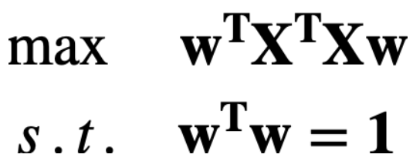

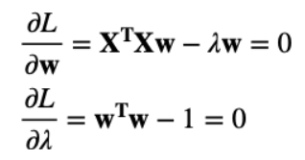
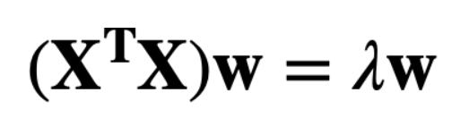
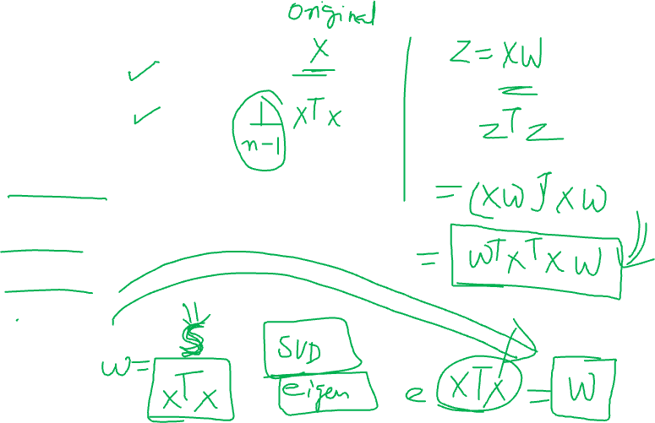
Optimization problem
Lagrangian method
Eigen value problem

Slide 44

Limitations of PCA
Sensitive to ouliers
Scaling of data is needed
Assumes that the features are linearly dependent
The transformed variables are linear combinations of original variables

Slide 45
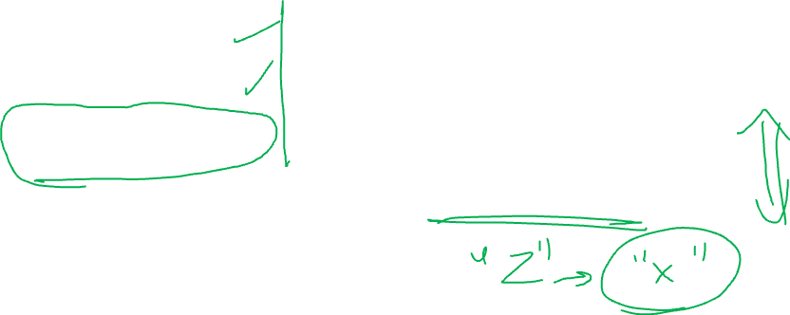

Dimensionality reduction: Summary
Pros
Cons
Memory saving
Speed up training
May filter our noise
Loss of information
Performance might go down
Makes the whole pipeline a bit more complex and harder to maintain

Slide 46

Advice on applying Dimensionality reduction techniques
General:
First, try to train the system with original data before resorting to dimensionality reduction
If the training is too slow, then resort to dimensionality reduction.
Dont bring the PCA/other dimensionality reduction in your main pipe-line of project initially

Slide 47
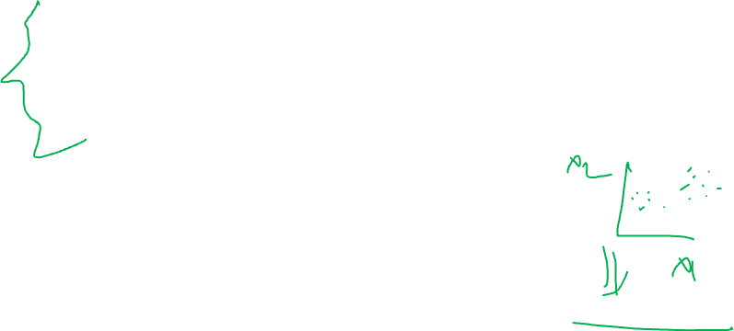
References
https://www.cs.princeton.edu/picasso/mats/PCA-Tutorial-Intuition_jp.pdf
Python Machine Learning, Unlock deeper insights into machine learning with this vital guide to cutting-edge predictive analytics - Sebastian Raschka
Hands-On Machine Learning with Scikit-Learn and TensorFlow: Concepts, Tools, and Techniques to Build Intelligent Systems - Aurélien Géron

Slide 48

THANK YOU

